Slide 1
SMART CAR PARKING USING IMAGE PROCESSING
Team-5

Slide 2
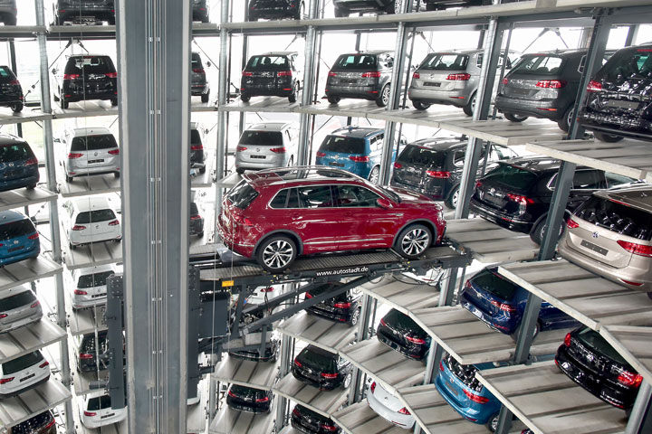
INTRODUCTION
Globalization has continually accumulated more individuals into urban territories causing significant urban communities like Bangalore to be vigorously populated and blocked. The expansion in population implies an expansion additionally in human mobility. This influences the expansion in the number of vehicles which thus influences the parking circumstance

Slide 3
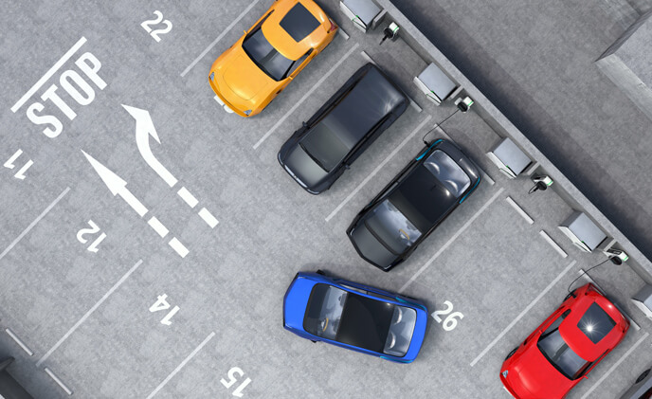
This project presents an image-processing based smart parking system developed for multi-storey parking garages, open parking lots and many more. The proposed system design through the Python and the OpenCV library utilizes the combined edge detection and coordinate bound pixel sections in deciding if a parking spot in the acquired footage is occupied or not.

Slide 4
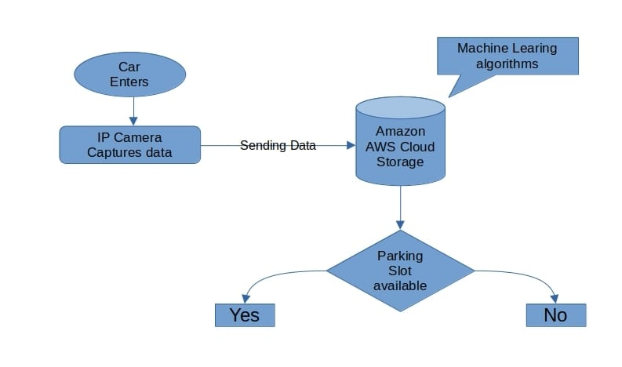

Slide 5
Libraries
OpenCV
OpenCV (Open Source Computer vision) is permitted for both scholastic and commercial use. It is a library of programming functions mainly aimed at real-time computer vision. OpenCV's application has wide areas which includes 2D and 3D feature toolkits, Ego motion estimation, Facial recognition system, Gesture recognition, Motion understanding, Object identification Segmentation and recognition and Motion tracking. OpenCV is written in C++.
Pickle
Python pickle module is used for serializing and de-serializing python object structures. The process to converts any kind of python objects (list, dict, etc.) into byte streams (0s and 1s) is called pickling or serialization or flattening or marshalling. We can converts the byte stream (generated through pickling) back into python objects by a process called as unpickling.

Slide 6
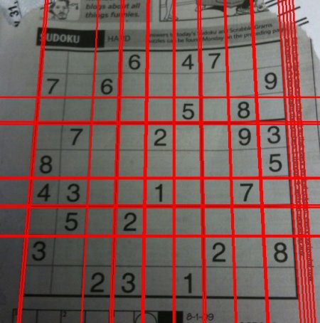
Hough Line Transform
The Hough Transform is a popular technique to detect any shape, if you can represent that shape in a mathematical form. It can detect the shape even if it is broken or distorted a little bit. The Hough transform is a feature extraction technique used in image analysis, computer vision, and digital image processing.

Slide 7
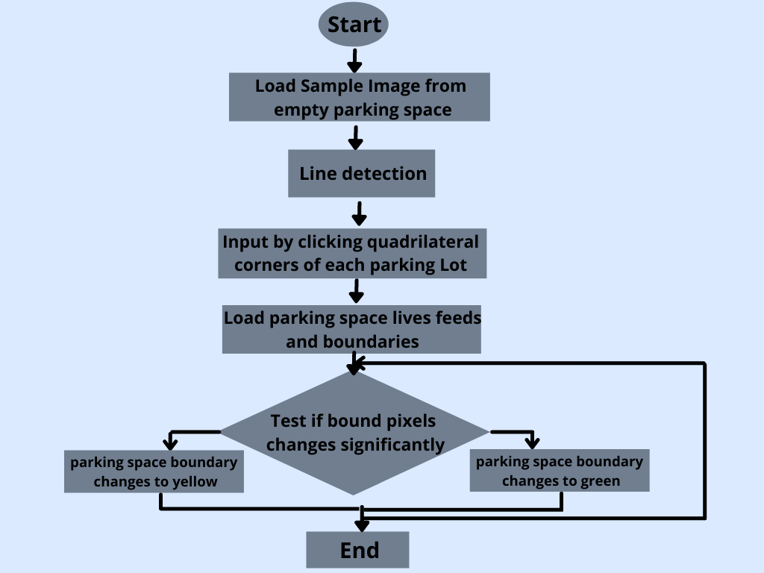

Slide 8
RGB vs Grayscale images​
It is important to distinguish between RGB images and grayscale images. An RGB image has three color channels: Red channel, Green channel and Blue channel. However, a grayscale image has just one channel.​
An RGB Image consists of 3 layers R,G,B. It’s a 3 dimensional matrix, where as grayscale image is of only 2 dimensions, and the values ranges between 0–255 (8-bit unsigned integers). Therefore, some algorithms can only applied on 2-D image rather than 3-D, hence we convert an RGB image into a grayscale image.​
The other reasons why we prefer grayscale images over RGB images are like Signal to noise ratio, Complexity of the code, Difficulty of visualization etc.​

Slide 9
What is NGINX?
NGINX is open source software for web serving, reverse proxying, caching, load balancing, media streaming, and more. It started out as a web server designed for maximum performance and stability. In addition to its HTTP server capabilities, NGINX can also function as a proxy server for email and a reverse proxy and load balancer for HTTP, TCP, and UDP servers.

Slide 10
Amazon Elastic Compute Cloud
Amazon Elastic Compute Cloud (Amazon EC2) is a web service that provides resizable computing capacity—literally, servers in Amazon's data centers—that you use to build and host your software systems.
Amazon Elastic Compute Cloud (Amazon EC2) provides scalable computing capacity in the Amazon Web Services (AWS) Cloud. Using Amazon EC2 eliminates your need to invest in hardware up front, so you can develop and deploy applications faster. You can use Amazon EC2 to launch as many or as few virtual servers as you need, configure security and networking, and manage storage. Amazon EC2 enables you to scale up or down to handle changes in requirements or spikes in popularity, reducing your need to forecast traffic.

Slide 11
Features of Amazon EC2
Virtual computing environments, known as instances
Preconfigured templates for your instances, known as Amazon Machine Images (AMIs), that package the bits you need for your server (including the operating system and additional software)
Various configurations of CPU, memory, storage, and networking capacity for your instances, known as instance types
Secure login information for your instances using key pairs (AWS stores the public key, and you store the private key in a secure place)
Storage volumes for temporary data that's deleted when you stop, hibernate, or terminate your instance, known as instance store volumes
Persistent storage volumes for your data using Amazon Elastic Block Store (Amazon EBS), known as Amazon EBS volumes

Slide 12
Features of Amazon EC2
Multiple physical locations for your resources, such as instances and Amazon EBS volumes, known as Regions and Availability Zones
A firewall that enables you to specify the protocols, ports, and source IP ranges that can reach your instances using security groups
Static IPv4 addresses for dynamic cloud computing, known as Elastic IP addresses
Metadata, known as tags, that you can create and assign to your Amazon EC2 resources
Virtual networks you can create that are logically isolated from the rest of the AWS Cloud, and that you can optionally connect to your own network, known as virtual private clouds (VPCs)

Slide 13
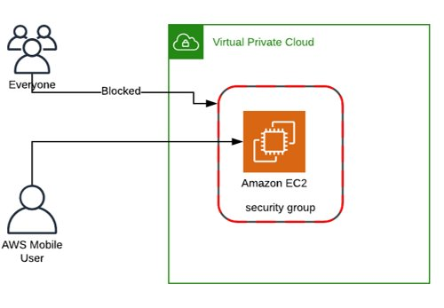
Security Groups:
AWS Security Groups are one of the many tools Amazon provides in accordance with their AWS Cloud Services.​
They basically act as a firewall, giving you control over both inbound and outbound traffic to your EC2 Instance. Whenever an EC2 instance is spun, it needs to be assigned to a particular Security Group.​
They are used to secure your EC2 instances and thus improve the security of your overall Cloud Environment. ​
This is extremely flexible and let's you configure Open Ports and Protocols for Users over the internet and much more.​

Slide 14
Nginix Load Balancer
Load balancing across multiple application instances is a commonly used technique for optimizing resource utilization, maximizing throughput, reducing latency, and ensuring fault-tolerant configurations.
instances of the same application running on srv1-srv3. When the load balancing method is not specifically configured, it defaults to round-robin. All requests are proxied to the server group myapp1, and nginx applies HTTP load balancing to distribute the requests.
http {
upstream myapp1 {
server srv1.example.com;
server srv2.example.com;
server srv3.example.com;
}
server {
listen 80;
location / {
proxy_pass http://myapp1;
}
}
}

Slide 15
Conclusion:
The car parking issue is unraveled utilizing IoT and Wi-Fi. By utilizing this proposed system, the accessibility of free openings is refreshed on the web server progressively.The fundamental favorable position of this system is to lessen time in an inquiry of free spaces, the client can get to the site viably, and decrease traffic blockage.
The other advantages of this project includes that it is cost free because most of the parking slots have surveillance camera but here we dont require any surveillance camera just need to additionally process the video.

